Slide 1
Overview of
Popular Cloud Services
AWS & Azure
AXA Business Services
DRReAM
August, 2020
Notes:
WARNING: if you try to copy/paste slides from a PPT presentation that doesn’t have this layout, you will probably face some technical issues.
To avoid such thing, you can click on ‘new slide’ in the top menu of this presentation and copy/paste the elements from your former slide onto the new one (but not the slide itself).

Slide 2

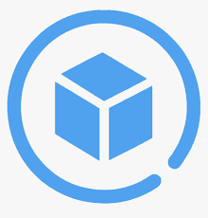

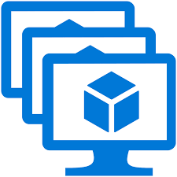
Compute Services
AWS | Azure | Usage
Elastic Compute Cloud (EC2) Instances | Virtual Machines | Virtual servers allow users to deploy, manage, and maintain OS and server software. Instance types provide combinations of CPU/RAM. Users pay for what they use with the flexibility to change sizes.
Auto Scaling | Virtual Machine Scale Sets | Allows you to automatically change the number of VM instances. You set defined metric and thresholds that determine if the platform adds or removes instances.

Slide 3





Authentication and Access Management Services
AWS | Azure | Usage
Identity and Access Management (IAM) | Azure Active Directory | Allows users to securely control access to services and resources while offering data security and protection. Create and manage users and groups, and use permissions to allow and deny access to resources.
Identity and Access Management (IAM) | Role Based Access Control | Role-based access control (RBAC) helps you manage who has access to Azure resources, what they can do with those resources, and what areas they have access to.
Multi-Factor Authentication | Multi-Factor Authentication | Safeguard access to data and applications while meeting user demand for a simple sign-in process.

Slide 4



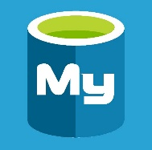
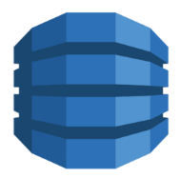


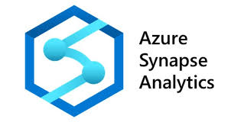
Storage Services
AWS | Azure | Usage
Simple Storage Services (S3) | Blob storage | Object storage service, for use cases including cloud applications, content distribution, backup, archiving, disaster recovery, and big data analytics.
RDS | MySQL, SQL Database, PostgreSQL | Managed relational database service where resiliency, scale, and maintenance are primarily handled by the platform.
DynamoDB, SimpleDB, DocumentDB | Cosmos DB | A globally distributed, multi-model database that natively supports multiple data models: key-value, documents, graphs, and columnar.
Redshift | Synapse Analytics | Cloud-based Enterprise Data Warehouse (EDW) that uses Massively Parallel Processing (MPP) to quickly run complex queries across petabytes of data.

Slide 5






Analytics Services
AWS | Azure | Usage
EMR | Databricks, HDInsight | Apache Spark-based analytics platform. Managed Hadoop service. Deploy and manage Hadoop clusters in Azure.
Data Pipeline, Glue | Data Factory | Processes and moves data between different compute and storage services, as well as on-premises data sources at specified intervals. Create, schedule, orchestrate, and manage data pipelines.
Glue | Data Catalog | A fully managed service that serves as a system of registration and system of discovery for enterprise data sources
Athena | Data Lake Analytics | Provides a serverless interactive query service that uses standard SQL for analysing databases.

Slide 6







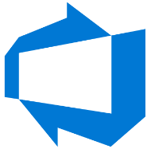

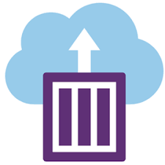
Other Services
AWS | Azure | Usage
QuickSight | PowerBI | Business intelligence tools that build visualizations, perform ad hoc analysis, and develop business insights from data.
Lambda | Functions | Serverless: Integrate systems and run backend processes in response to events or schedules without provisioning or managing servers.
CloudWatch, X-Ray | Application Insights, Monitor | Monitoring and observability services providing data and actionable insights of applications/resources.
CodeBuild, CodeDeploy, CodeCommit, CodePipeline | DevOps | A cloud service for collaborating on code development.
Elastic Container Service, Elastic Kubernetes Service, Fargate | Container Instances, Kubernetes Service, Service Fabric | Run applications inside containers with/without a higher level orchestration service, option to go serverless.

Slide 7
Thank you

